Slide 1
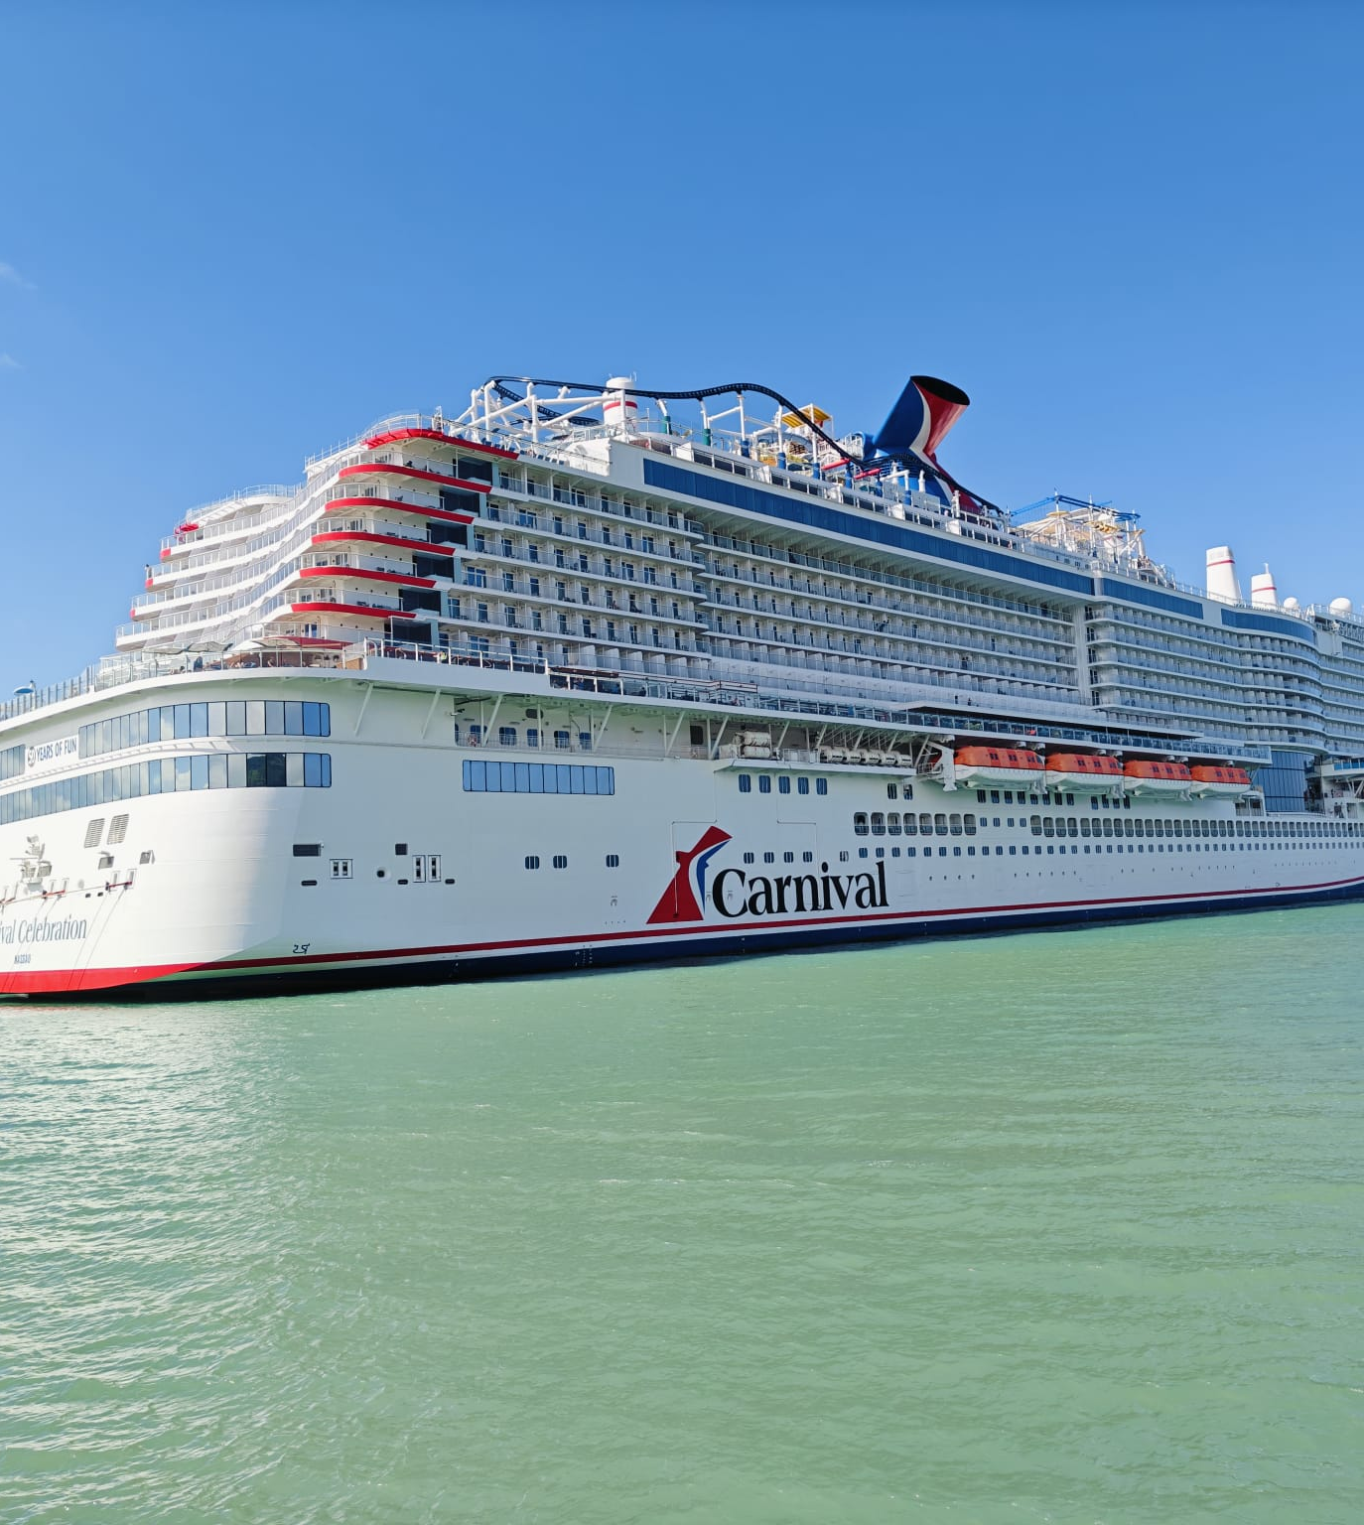
Why You Should Go On The Cruise Line Management Study Abroad

Slide 2
What is this program?
This program is a once and a lifetime to experience the cruise line and tourism industry in a first-hand environment. This class has 5 weeks of in-person lectures about the cruise line industry and then a week over spring break onboard the ship and at all the ports of call.

Slide 3
What This Program Provides To You
This program provides real-life firsthand experiences to students here at IU Indianapolis to see things they may have never traveled before.
As well it provides an educational experience to see how these cruise and tourism industries work and function.

Slide 4
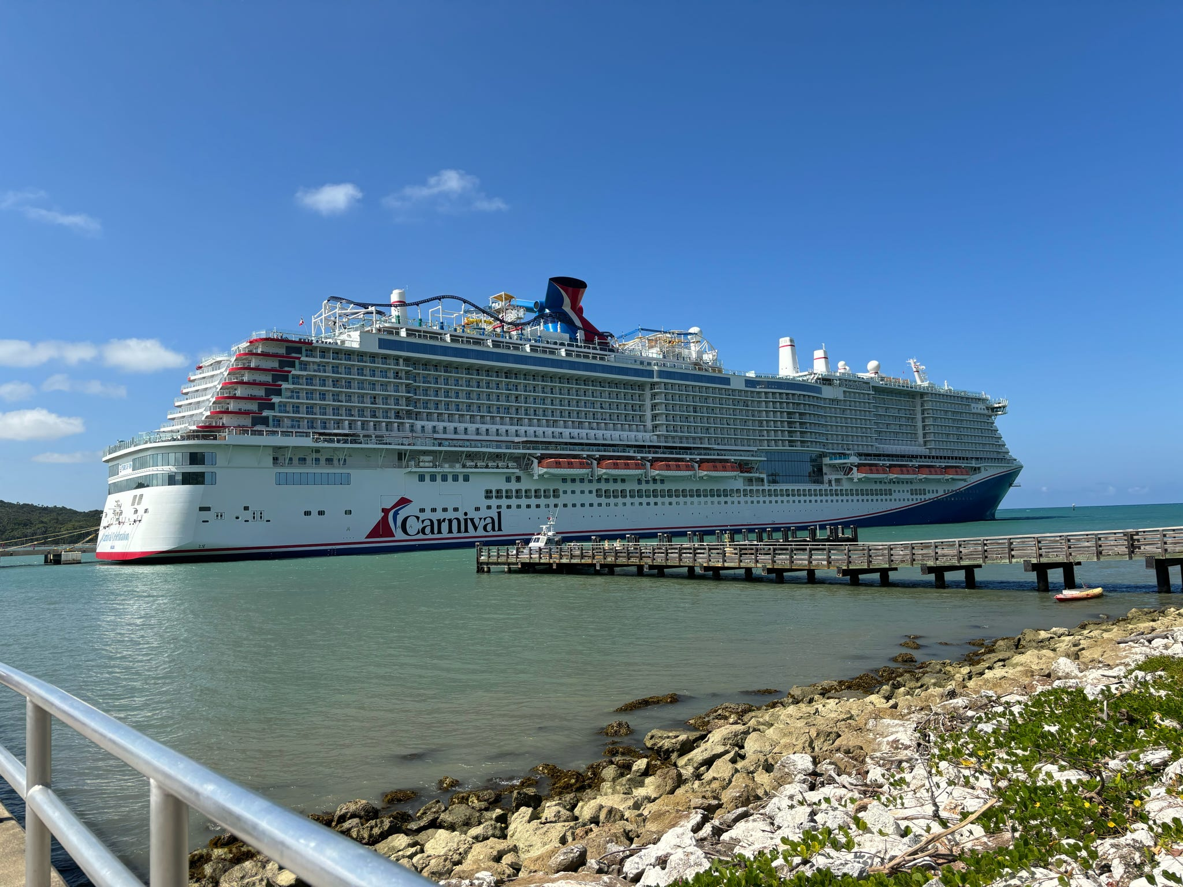
What It Provides To You Professionally
It provides the chance to experience and see different sectors of the tourism and cruise industry.
As well as many interviews with vital cogs in the industry in class and at port sports management also works hand in hand to provide experiences and tourism to all regions of the world.

Slide 5
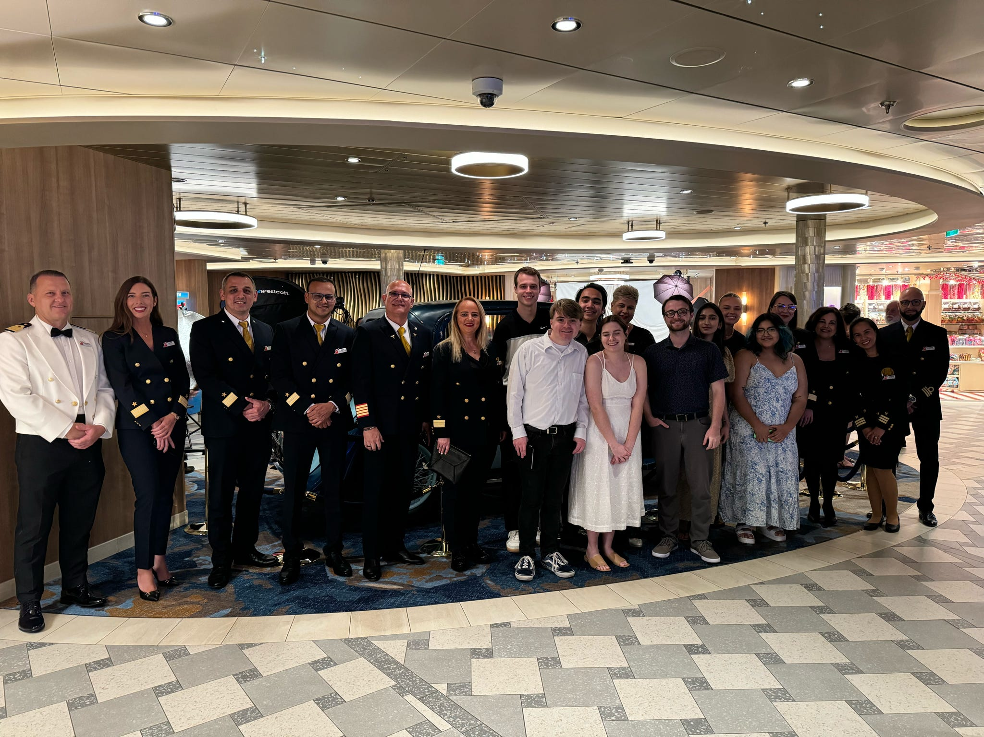
What It Provides To You Personally
Personally, it provides you as a student to see the world for college credit and honors credit if in the honors college.
You get to see and be immersed in other cultures and meet other students from our schools even other domains.

Slide 6
Why Should You Go If Not A Tourism Student?
This opportunity provides a great experience to learn and understand the tourism industry and its relation to other majors.
At the Westin in the USVI and many other ports vital staffers and members of the tourism industry told us that many industries and backgrounds are needed from business, sports, medical, and many more.
This provides these students the chance to see what’s available abroad compared to what’s available domestically.

Slide 7
Summary
This program is a great experience that I enjoyed and want to encourage students to attend, if possible!
You learn so much in a brand-new format of learning.
Meet new people from IUI and outside of IUI.
Get to be apart of new cultures.
All while having fun for college credit and at a significantly cheaper value than booking by yourself for a cruise!
So go with Amy and enjoy your spring break for college credit!

